Slide 1

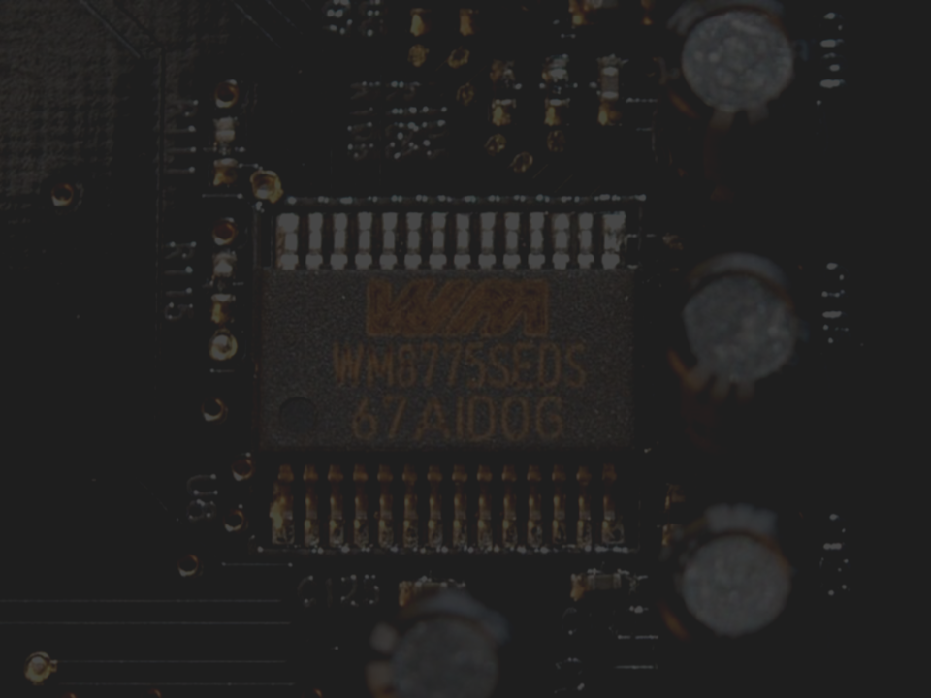



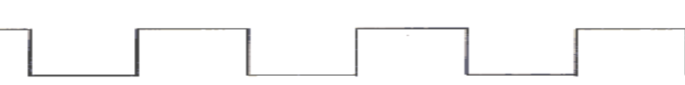
By Andrew Ribeiro

Slide 2
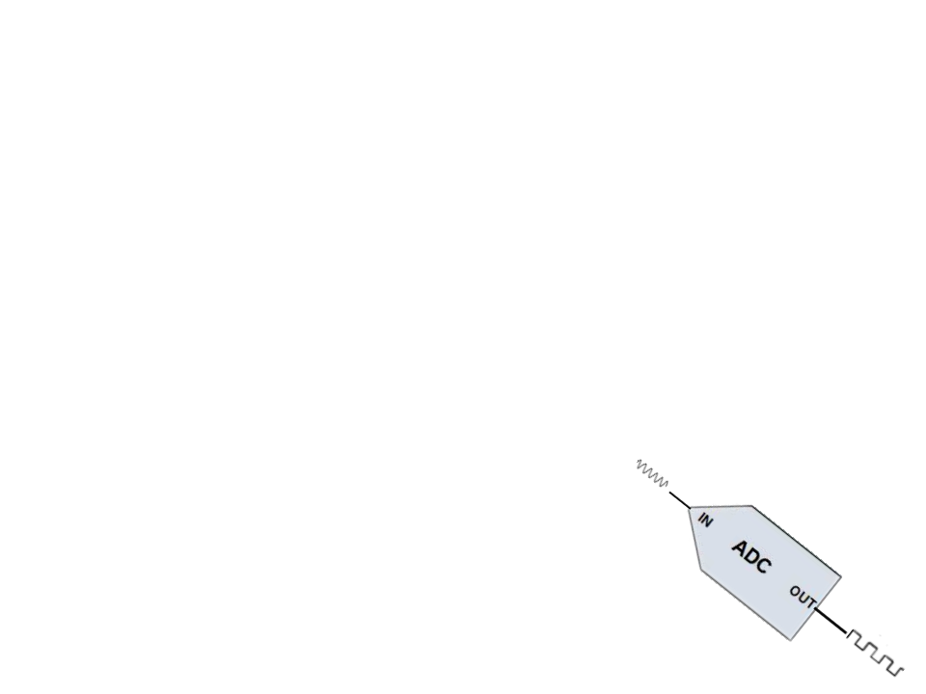

What is analog and digital?
Analog-to-digital converters (ADC’s)
Types of ADC’s
Pulse Code Modulation
Factors in Analog-to-Digital Conversion
Applications of ADC’s
Digital-to-analog converters (DAC’s)
Types of DAC’s
Pulse width modulation
Applications of DAC’s
Examples
Q & A
4/29/2009
Andrew Ribeiro- CS 215

Slide 3

Analog is a term that is used to describe continuous (infinite range of values) variable signals that occur in the physical world.
Examples of analog signals:
Pressure
Voltage
Current
Sound
Light
4/29/2009
Andrew Ribeiro- CS 215

Slide 4

Digital is a signal that consists of two discrete values- 0 and 1.
Digital signals are usually in the form of voltage, where high voltage near +5v is considered a one and low voltage near +0v is considered a zero.
4/29/2009
Andrew Ribeiro- CS 215

Slide 5
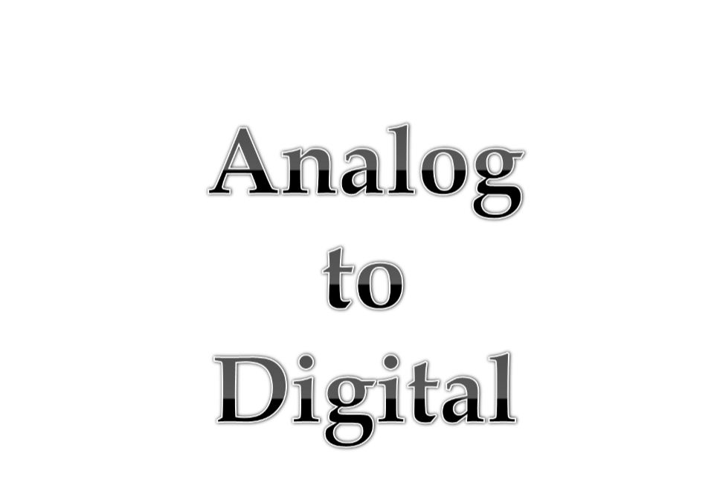
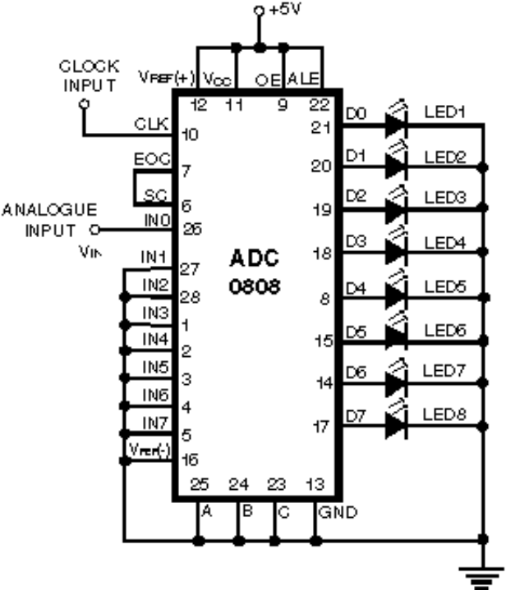
Analog to digital
4/29/2009
Andrew Ribeiro- CS 215

Slide 6

Devices called Analog-to-digital converters (ADC’s) are used.
There are many ways to implement ADC’s.
Each have their own benefit and downfall.
Not every ADC is equally applicable to every application
4/29/2009
Andrew Ribeiro- CS 215

Slide 7

Pulse Code Modulation
Simplest type
Direct Conversion
Ramp-Compare
Wilkinson
First type of ADC
Successive-Approximation
4/29/2009
Andrew Ribeiro- CS 215
Notes:
Will focus on one of the ADC’s: Pulse Code Modulation

Slide 8

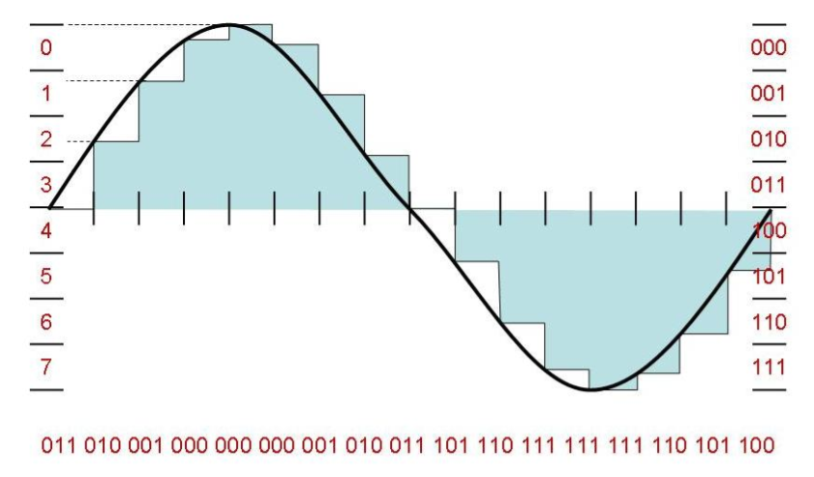
Pulse code modulation is a way to quantify( assign a number to)
analog data. This form of quantification is also a convenient way
to convert analog-to-digital.
Analog signals such as voice, or any continuous variable signals,
can be digitized, or converted into a train of pulses( or a series
of pulses) whose amplitude can achieve certain discrete levels.
4/29/2009
Andrew Ribeiro- CS 215

Slide 9

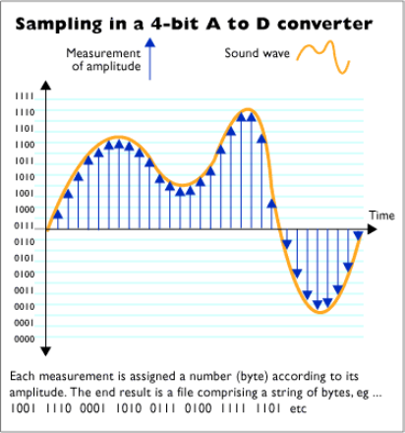
Resolution: also known as the sampling resolution. Is the range or scope of numbers that analog data can be converted to. The resolution is always a power of 2 so it can be represented in binary.
Standard voice transmission has a resolution of 2³ = 8 bits. Also, this is the standard for commercial digital voice circuits.
Hi-fi (high fidelity) has a resolution of 2⁴ = 16 bits. This sampling resolution is adequate for things such as music production.
This ADC can represent values in an analog signal with only 16 numbers.
Obviously this resolution is low and would hardly quantify the signal correctly.
4/29/2009
Andrew Ribeiro- CS 215

Slide 10

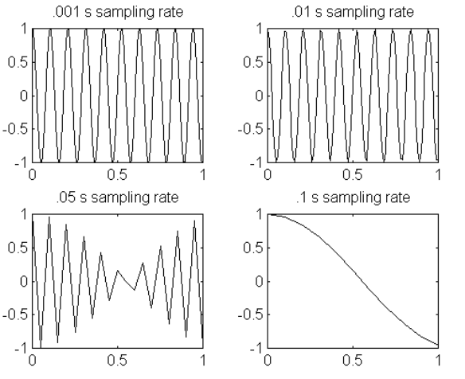
Aliasing is an issue when converting analog signals that have a higher frequency than the sampling rate that degrades the integrity of the original analog signal.
For example, a 2 kHz sine wave being sampled at 1.5 kHz would be reconstructed as a 500 Hz sine wave. (From Wikipedia)
Anti-aliasing is used to reduced Aliasing. This is done by implementing a low-pass filter on an ADC. This removes the analog signal that would cause Aliasing (or distortion of the data when put outputted through a DAC).
4/29/2009
Andrew Ribeiro- CS 215
Notes:
Anti-Aliasing does not allow higher frequency signals in so that the output signal is not distorted.

Slide 11
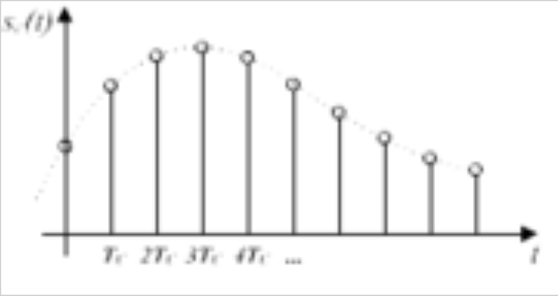
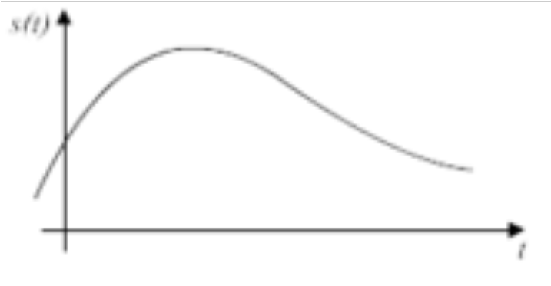
Sampling Rate: is the efficiency with which a signal can be digitized. The sampling rate depends on the frequency( time per interval) at which the sampling is done.
Sampling rate must be at least twice the highest data frequency.
Commercial voice standard sampling rate is 8 kHz.
Hi-fi digital sampling rate is 44.1 kHz.
Analog signal (continuous variable range of values)
Sampled signal (with quantified discrete values)
4/29/2009
Andrew Ribeiro- CS 215
Notes:
he sampling rate, sample rate, or sampling frequency defines the number of samples per second (or per other unit) taken from a continuous signal to make a discrete signal.

Slide 12

Pulse code modulation is used to convert analog-to-digital in various applications. Such as:
Digital telephone systems
Musical keyboards
Digital audio in computers.
Digital video
CD “Red Book Format” – CD standard.
Note: Not used typically for standard video and DVD or DVDR because of the high bit rate.
4/29/2009
Andrew Ribeiro- CS 215

Slide 13

Analog-to-digital converters are used in many applications. These include:
Process Control (of machine systems)
Sensors
Weigh Scale
Pressure
Temperature
Etc..
Instrumentation
Gas Monitoring
Medical instrumentation (EKG’s)
A/V devises
4/29/2009
Andrew Ribeiro- CS 215

Slide 14
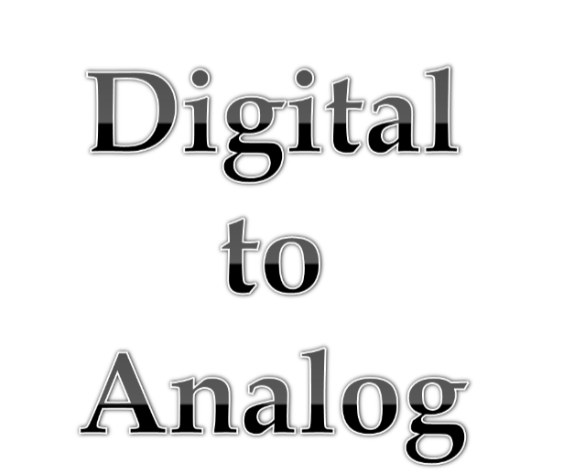
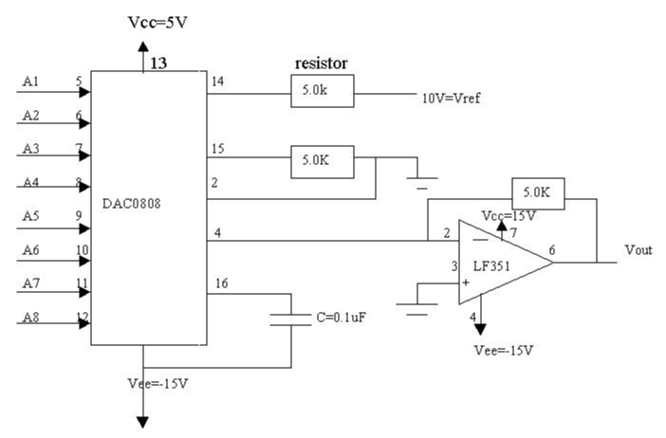
4/29/2009
Andrew Ribeiro- CS 215

Slide 15

Converts discrete value into analog signal- usually in the form of voltage.
Devices called Digital-to-analog converters (DAC’s) are used.
There are many ways to implement DAC’s.
Each have their own benefit and downfall.
4/29/2009
Andrew Ribeiro- CS 215

Slide 16

Pulse Width Modulator
Simplest type
Oversampling
Thermometer Coded
Binary Weighted
Hybrid
Segmented DAC
4/29/2009
Andrew Ribeiro- CS 215
Notes:
Will focus on one of the DAC’s: Pulse Width Modulator

Slide 17

Pulse width modulation is used to:
To digitally create an analog output voltage level for control functions and power supplies.
To digitally create analog signals for arbitrary waveforms, sounds, music and speech.
4/29/2009
Andrew Ribeiro- CS 215

Slide 18

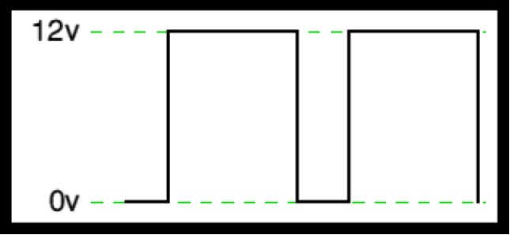
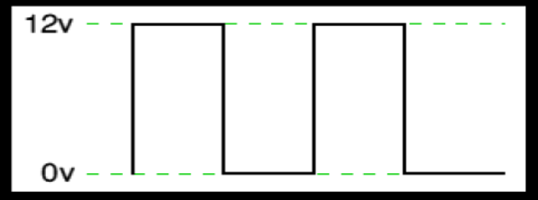
Pulse width modulation modulates its duty cycle( width of pulses of zeroes and ones) to convey digital information over an analog signal.
The way Pulse width modulation works is by increasing or decreasing the average output voltage by increasing or decreasing the width of the pulses.
The average voltage for this duty cycle is 6 volts. Because the width
Of each pulse is the same.
The pulse width here is increased thereby changing the average voltage
In this duty cycle to 9v.
4/29/2009
Andrew Ribeiro- CS 215
Notes:
Can cause variable voltage output by doing this.

Slide 19
Note that an analog signal that is pulse modulated must be read into a tuned device or proper device that can use pulse modulated waves.
Any shape waveform can be generated by outputting a sequence of PWM values that correspond to multiple points on the waveform. When you use more points, heavier filtering and greater PWM resolution, you can represent fast waveforms with great accuracy.
4/29/2009
Andrew Ribeiro- CS 215

Slide 20
Audio amplification
Motor control
Primary use
Micro controller analog output
Telecommunications
High-Fidelity audio
4/29/2009
Andrew Ribeiro- CS 215
Notes:
Telecommunications: In telecommunications, the widths of the pulses correspond to specific data values encoded at one end and decoded at the other.
Pulses of various lengths (the information itself) will be sent at regular intervals (the carrier frequency of the modulation).

Slide 21

CD players
Mp3 Players
Sound cards
Video
RAMDAC
Used to display digital information on a monitor.
I.e. displaying an image.
4/29/2009
Andrew Ribeiro- CS 215

Slide 22

Wikipedia (Images)
http://en.wikipedia.org/wiki/Pulse-code_modulation
Teach yourself electricity and electronics
Author: Stan Gibilisco
Published by: McGraw-Hill (2006)
Analog.com
http:/http://www.analog.com/library/analogDialogue/
Curtin University Of Technology
http://www.cage.curtin.edu.au/mechanical/info/vibrations/tut3.htm
DataDog.com
http://www.datadog.com/
4/29/2009
Andrew Ribeiro- CS 215

Slide 23


4/29/2009
Andrew Ribeiro- CS 215

